Slide 1
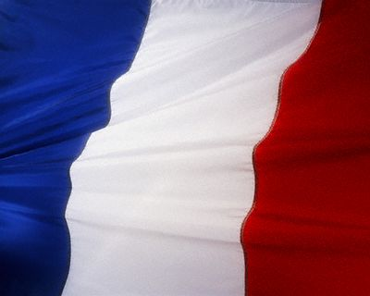
Les Régions de la France

Slide 2
Les Régions de la France

Slide 3
Le Nord de la France

Slide 4
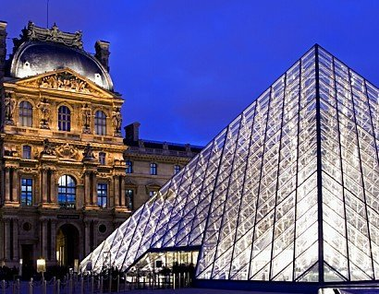
Île-de-France - Paris
In Paris, the controversial modern glass pyramid in the Louvre courtyard was built in the late 1980’s by the Chinese-American architect I.M. Pei. Some feel that its modern style clashes with the Louvre’s classic construction.

Slide 5
La Tour Eiffel
Named after its designer, engineer Gustave Eiffel, the Eiffel Tower is the tallest building in Paris. More than 200,000,000 people have visited the tower since its construction in 1889.
http://en.wikipedia.org/wiki/Eiffel_Tower

Slide 6
Notre-Dame
"We must remind ourselves that these monumental structures, although they remain intensely alive, are merely the skeletons of the cathedrals of medieval times. Compared with what it was when first created, the cathedral, as we see it now, is like a venerable old lady whose noble carriage barely suggests the striking belle she must have been in her youth. We should not only recall the past splendor of the cathedral, most of whose external adornment is now lost, but also attempt to understand what the cathedral was during the progress of its own creation; the role it played at the heart of the city that saw its birth among the people whose stubborn or enthusiastic will alone caused its skyward thrust."
—Zoe Oldenbourg, 'With Stone and Faith'

Slide 7
Notre-Dame de Paris
Notre Dame de Paris ('Our Lady of Paris') is a Gothic cathedral on the eastern half of the Île de la Cité in Paris, France, with its main entrance to the west.
It is widely considered one of the finest examples of French Gothic architecture.

Slide 8
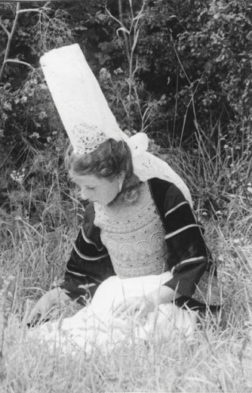
Bretagne
La coiffe bretonne
un costume traditionnel des femmes se compose souvent d’une jupe et d’une blouse,ou d’une robe de tissue ou un col en dentelle (lace) et une coiffe (hat).

Slide 9
Bretagne – des sabots
Le costume d’homme se compose généralement d’un pantalon décoré, d’une chemise blanche et d’un gilet. Les chaussures traditionnelles des Bretons sont en bois (wooden). On les appelle des sabots.

Slide 10
Bretagne - Les crêpes

Slide 11
Alsace
No other dish shows off the richly varied charcuterie of Alsace quite like choucroute.

Slide 12
Pays de la Loire
Chambord

Slide 13
Les châteaux (castles)
The castles of the Loire Valley are renowned the world over. Altogether there are more than 300 châteaux in the region, many built in the heyday of the French royalty and nobility (17th-18th centuries). There are also often lavishly planted gardens around the châteaux - the origins of the 'French Style' garden are here - which are often as interesting as the chateaux themselves.
Some of the Loire chateaux are now open to the public, while others are established as fine hotels, and many are still in private ownership.

Slide 14
Château de Versailles

Slide 15
Poitiers
The Futuroscope is a cinematic theme park in Poitiers that offers a circular-screen theater, 3-D movies, a hemispherical theater, a large movie screen (le kinémax), and a computerized audiovisual spectacle shown on ten screens.

Slide 16
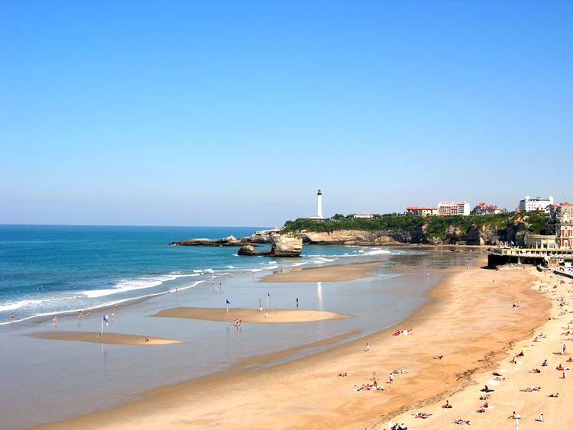
Les plages de Biarritz
In Southwestern France, Biarritz is a fashionable beach resort. Known as “the queen of resorts and the resort of kings,” Biarritz has boasted visits by Queen Victoria, Edward VII, and Alfonse XIII of Spain.

Slide 17
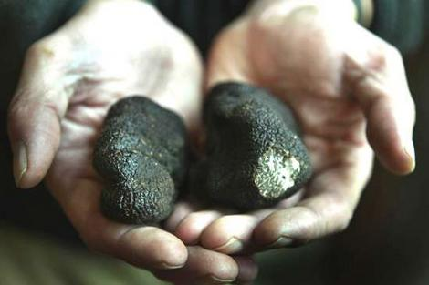
Le Périgord
The area is noted for its cuisine, more particularly its products related to ducks and geese, such as foie gras. It is one of the truffle areas of France, historically the most famous.

Slide 18
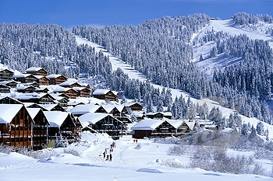
Savoie et Haute-Savoie
Savoie on the Italian border, and Haute Savoie on the Swiss border, are popular ski areas. Their snow-capped mountains are some of the highest peaks in Europe.

Slide 19
Provence
"Provence is one of those rare places that sets a mood from the moment you lay eyes on it.”
~ William Dowd

Slide 20
La bouillabaisse
La bouillabaisse, known as fish soup, is a specialty from the Provence region.

Slide 21
Languedoc - cassoulet

Slide 22
Cassoulet
The French like to think of their classic dishes as having been born, not made. Thus, cassoulet, the famous bean casserole of the Languedoc region in southwestern France, is said to have been born in Castelnaudary, about midway between Carcassonne and Toulouse. The legend is that during the Hundred Years War, when Castelnaudary was being besieged by the English, the starving inhabitants pooled their few provisions -- white beans, lard, sausage and confit d'oie, or preserved goose -- and cooked them in an earthenware pot in a wood-fired oven. And so was born cassoulet.
- The New York Times

